Slide 1
Demographics
Andrew Hewitson
Tina Lu
Oday Brahem
Maria Rodriguez

Slide 2
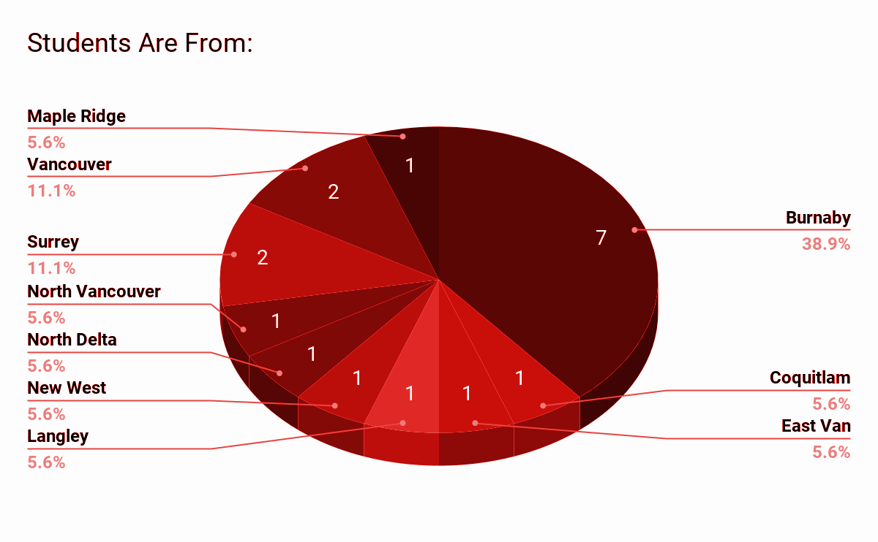
Where Does Everyone Live?
Burnaby = 7
Coquitlam = 1
East Van = 1
Langley = 1
New West = 1
North Delta = 1
North Vancouver =1
Surrey = 2
Vancouver = 2

Slide 3
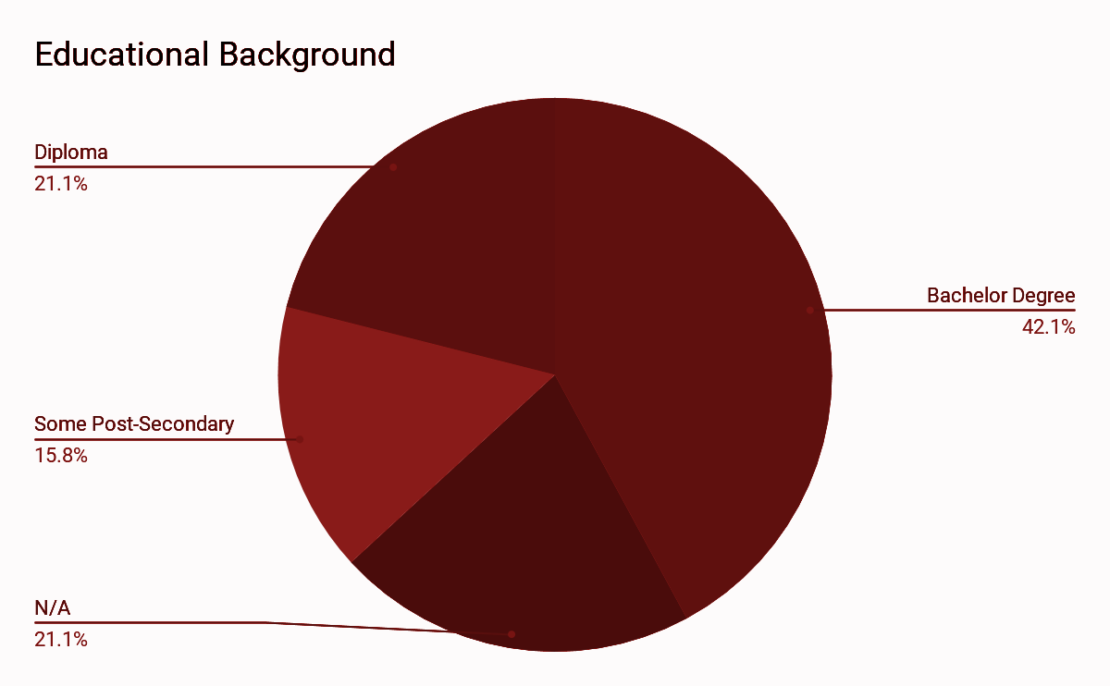
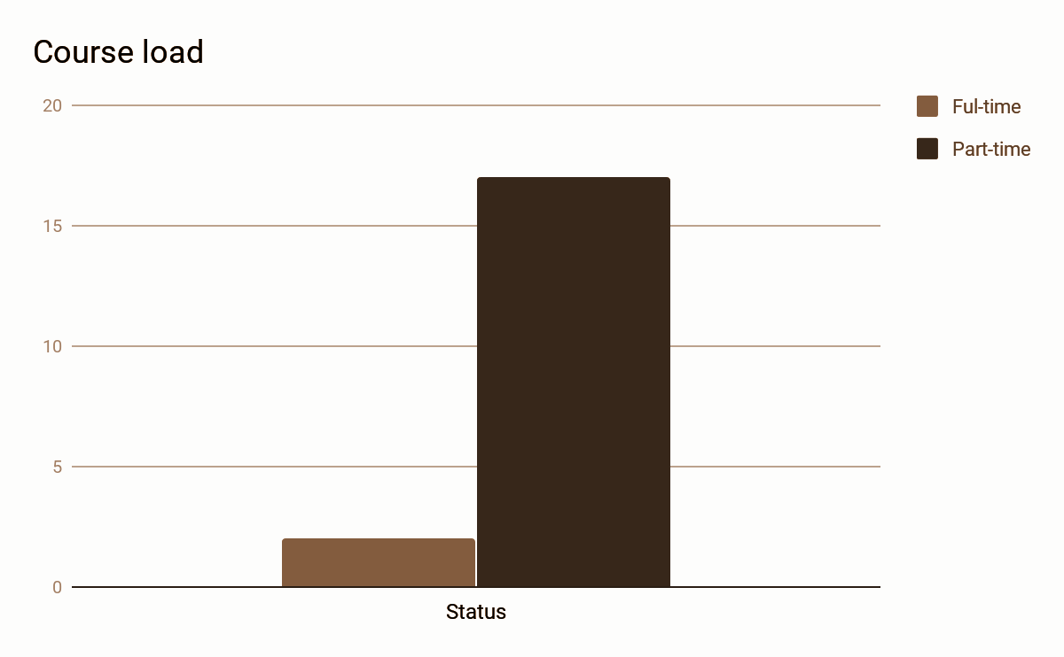
Educational Background

Slide 4
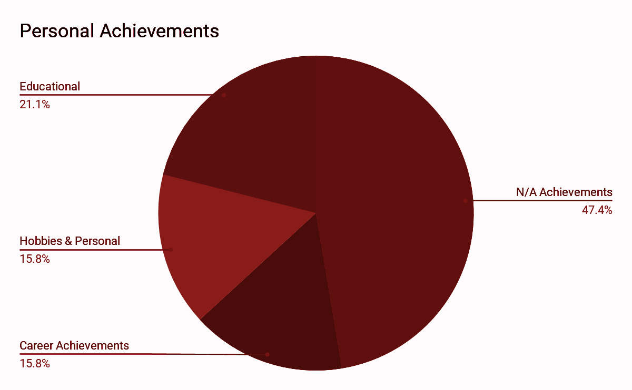
Personal Achievements

Slide 5
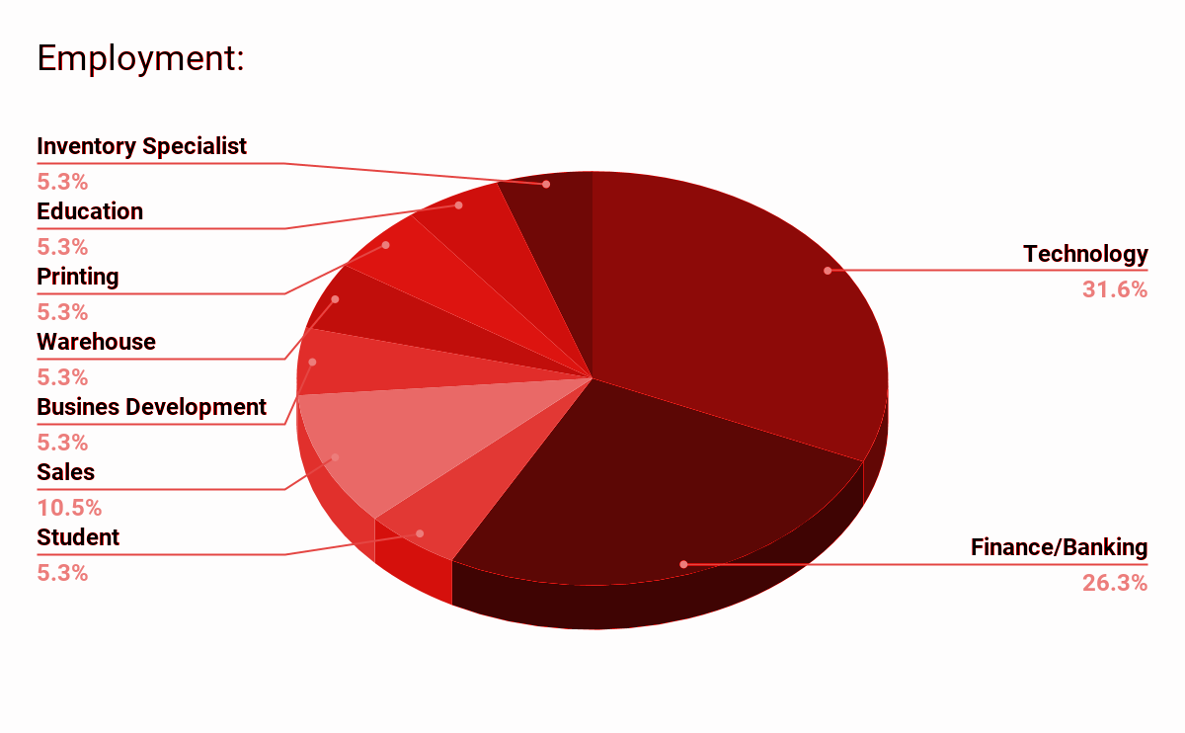
Work Industry
Technology : 31.6%
Finance and Banking Industry : 26.3%
Inventory Management : 5.3%
Printing: 5.3%
Warehouse : 5.3%
Business Development : 5.3%
Sales : 10.5%
Education : 5.3%

Slide 6
Hobbies
The most popular : Travel (31%)
Interesting group:
Cooking | Trevor Chapman | Ronyta Dhununjoy
Music | Kashton Chueden | Andrew Wu | Maria
Book Club | Ronyta Dhununjoy | Tina Lu | Trevor Chapman (writing)
Technique | Victor Siu (webdev) | Oday Braham (robots ) | Jeffrey Zhu (algorithms )
Biking | Samantha Nelson | Andrew Hewitson
Hiking | Ronyta Dhununjoy | Nishil

Slide 7
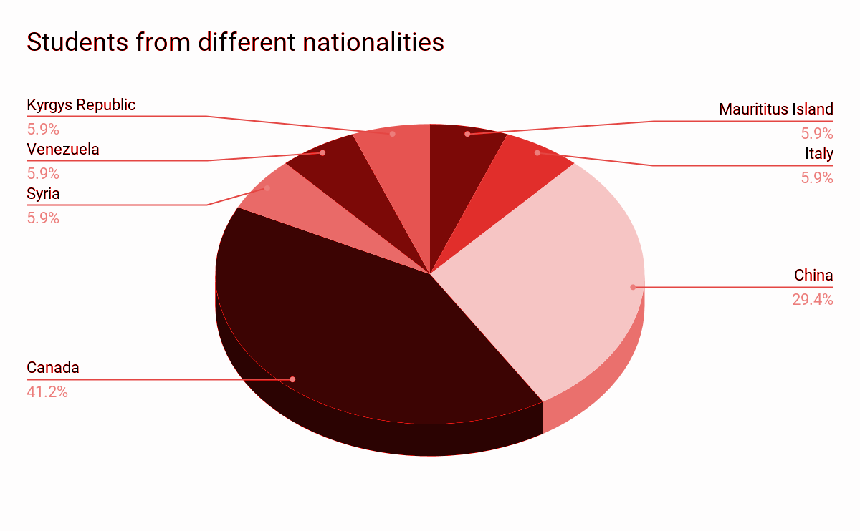
Where were you born?
41% fluent in English
59% ESL students

Slide 8
Commute to BCIT
Commute way: Car 47%, Transit 37%
Carpool or accompany choice:
New West | Nishil | Oday Braham
Surrey | Hans Hwang | Li Wang
Vancouver | Maria | Jeffrey Zhu
Burnaby | Allan Marcel | Jason Zhu
 | Mengjun Wang ( Ivan) | Tina Lu
 | Trevor Chapman | Victor Siu
 | Ronyta Dhununjoy

Slide 9
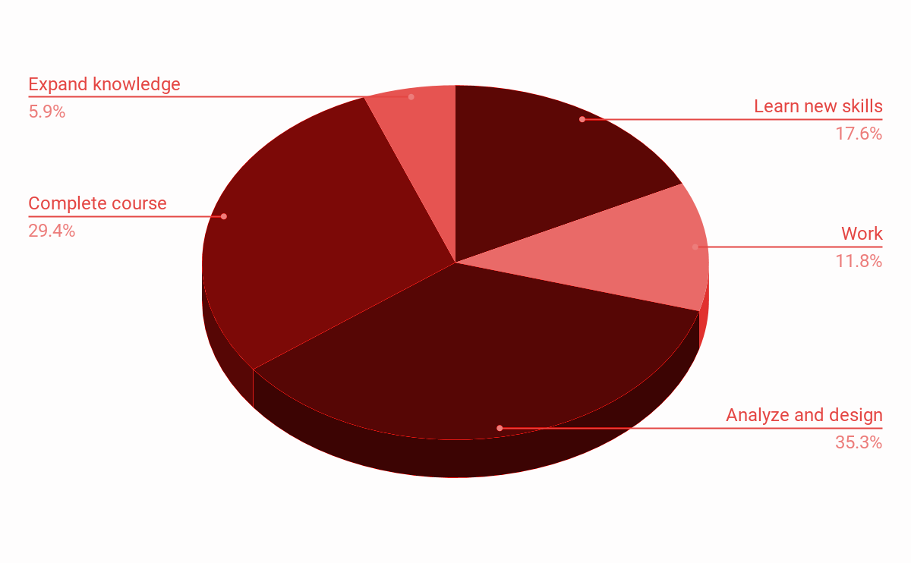
General Goals
Skills: work in team, learn AGILE, communication
Work: get new opportunities, improve practices with team, understand clients needs
1
3
5
2
6

Slide 10
Thank you!

